Slide 1

Gotham
Phase 3 - After changes
T-DIT-700 MSc2020
Gotham T-DIT-700

Slide 2
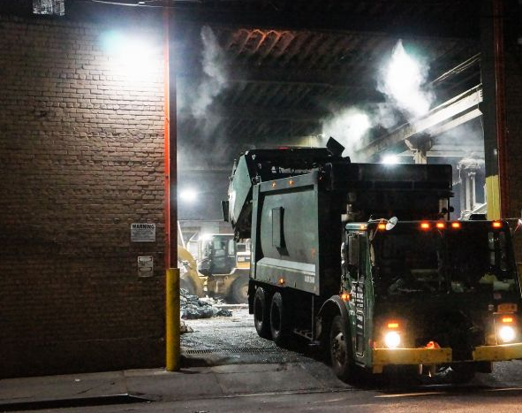
Summary 1. Introduction 2. Remainder of change 3. Identify metrics 4. Get feedback 5. Action plans 6. Celebrate success 7. Conclusion

Slide 3
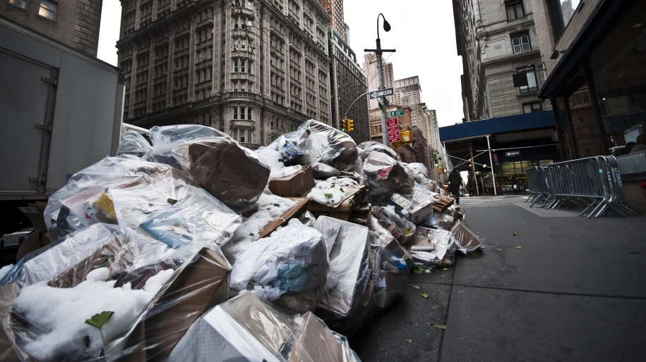
Introduction
The city hall has decided to implement a vast change plan in order to renew and reorganize its garbage collection system.
This implementation plan is about to be finalized
How to reinforcing changes ?

Slide 4








Reminder of changes decided by the town hall
1- Use the working time app
2- Equip trucks with GPS
3 – Equip employees with electronic device
4 - Use drones to check the collections and the state of cleanliness of the streets
5 – Smart trashes, with sensor
6 – Public app for incident reporting
7 – Monthly performance reporting

Slide 5
Identify metrics
Metrics allow us to have an accurate picture of the state of change
Help identify problems in the implementation
Used to verify success
Allow to have tangible data in order to make informed decisions

Slide 6
Get feedback
Important to know the feeling of the people affected by change :
In order to develop corrective action plans and achieve success
To implement actions that strengthen the adoption to change
We use the ADKAR form template to collect individual feedback, it covers all areas affected by a change

Slide 7
Action plan
After analyzing the metrics and feedbacks, we must set up action plans to :
Reinforcing the change adoption
Correct the course if the objectives are not reached

Slide 8
Celebrate success
To encourage teams and congratulate them, we must celebrate success, it allows to :
Strengthen support for change
Boost team moral after a difficult period of change

Slide 9
Conclusion
During this project we saw all the necessary steps for the success of a large-scale project and the importance of change management.
We used discord, Microsoft teams and shared documents to facilitate exchanges within the team

Slide 10

Thank you for listening
Do you have questions ?

